Slide 1

CS401 Modern Programming Practices (MPP) Professor Paul Corazza
MAHARISHI UNIVERSITY of MANAGEMENT
Engaging the Managing Intelligence of Nature
Computer Science Department

Slide 2
Lecture 6: Advanced Swing

Slide 3
Wholeness of the Lesson
Swing is a windowing toolkit that allows developers to create GUIs that are rich in content and functionality. The ultimate provider of tools for the creation of beautiful and functional content is pure intelligence itself; all creativity arises from this field’s self-interacting dynamics.

Slide 4
Introduction to Java's UI Libraries
Java Swing is a part of Java Foundation Classes (JFC) that is used to create window-based applications. It is built on the top of AWT (Abstract Windowing Toolkit) API and entirely written in java.
Sun’s AWT. The original version of Java (jdk1.0) came with a primitive windowing toolkit (the AWT) for making simple GUIs. GUI components were built by using the native GUI toolkit of the target platform (Windows, MacIntosh, Solaris, etc). It is platform dependent.
Unlike AWT, Java Swing provides platform-independent and lightweight components.

Slide 5
AWT Still Used. Swing components still make use of aspects of the AWT – Swing is built “on top of” the old AWT. In particular, handling of events relies on the old event-handling model.
JavaFX. In 2014, Oracle declared that Swing libraries would be developed no further, and that the windowing toolkit of choice had become JavaFX.
Return of Swing. In 2018, Oracle announced that, starting with JDK 11, JavaFX will no longer be bundled with the JDK, but will be available through a separate download. On the other hand, Oracle has announced that it will resume support of Swing (along with AWT) in JDK 8 and 11 and for the foreseeable future.

Slide 6
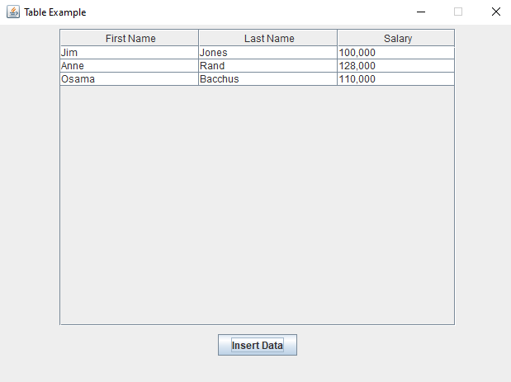
Using Tables
Steps for creating a table in Swing:
1. Create a new JTable 2. Embed the table in a JScrollPane
3. Add the scrollpane to the main panel
4. Set up a table model and insert model into table
5. Provide an updateModel method so that data in the table can be modified as application executes.
See demo: ProjectSwingSampleCode tables.TableSample.java

Slide 7
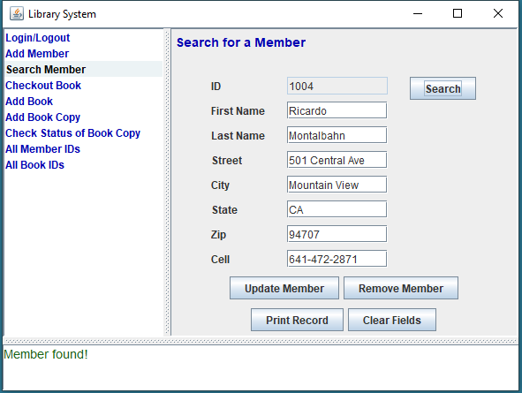
Intro to Split Panes and CardLayout
Use SplitPane to partition main window into content (right pane), control (left pane), status bar (bottom pane).
CardLayout allows you to display different panels within the same area. Here, the content panel that is shown is controlled by a JList in the left pane.
Use a CellRenderer to control highlighting on the JList elements

Slide 8

Working with JLists in Swing
One versatile component in Swing is a JList, which displays selectable lists.
JLists are often embedded in a JScrollPane to support changes in the size of the list. mainScroll = new JScrollPane(mainList);
It is possible to load data for a JList directly, but the best practice is to load it using a list model.
JList<String> list = new JList<String>(listModel); A list model keeps data separate from its presentation – this supports the MVC design pattern, which allows presentation and data to change independently. For example, you can present the same data in multiple ways. See the package lesson6.lecture.jlist

Slide 9
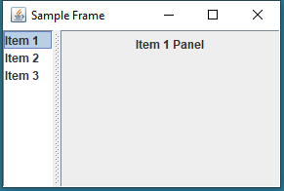
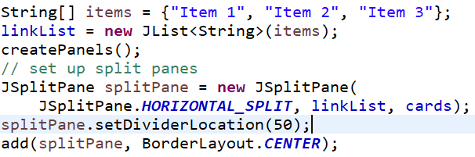
Working with SplitPane lesson6.lecture.splitpane
Create a left and right component to be displayed in the split pane. Here we have a JList on the left and a bundle of JPanels (called cards) on the right
Create a new SplitPane instance and set the divider location.
Add your SplitPane to the contentpane

Slide 10
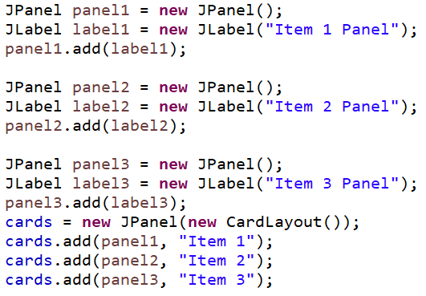
Setting up a CardLayout
Create JPanels that you wish to present
Create a new JPanel that will be given CardLayout as its LayoutManager. (Here, this JPanel is called cards.)
Add your panels to the CardLayout and specify in the second argument a key that can be used to locate each JPanel in the CardLayout. Here, the keys are "Item 1", "Item 2", and "Item 3".
lesson6.lecture.splitpane

Slide 11
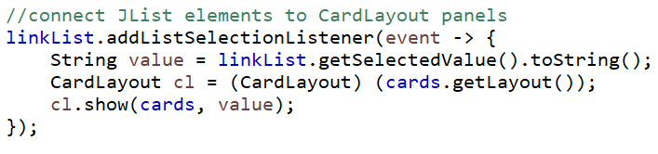
Controlling CardLayout with JList
Use a ListSelectionListener to connect the JList to the CardLayout
When a list item is selected, read the selected value
Use the value as a key to ask CardLayout to display the corresponding JPanel.
Demo: lesson6.lecture.splitpane

Slide 12
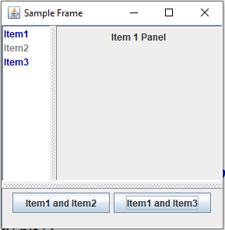
Control Function and Appearance of JList Using a CellRenderer
A CellRenderer allows you to control the color of the list items and to dynamically disable/enable their function for displaying panels in the right pane.
For this kind of control, the JList needs to be created using a ListModel and items inserted into the Model will have both a String value (which is displayed in the left panel) and another value that will determine the properties of each list item (its color, and whether enabled or disabled).
See the demo: lesson6.lecture.cellrenderer

Slide 13
Connecting the Parts of Knowledge With the Wholeness of Knowledge
The self-referral dynamics
arising from the reflexive association of container classes
In Swing, components are placed and arranged in container classes for attractive display.
In Swing, containers are also considered to be components; this makes it possible to place and arrange container classes inside other container classes. These self-referral dynamics support a much broader range of possibilities in the design of GUIs.
Transcendental Consciousness: TC is the self-referral field of all possibilities.
Wholeness moving within itself: In Unity Consciousness, all activity is appreciated as the self-referral dynamics of one's own Self.

